Slide 1
On Call Alert Escalation System
Vivek Jaiswal
Product Engineer Intern
© 2023 Sprinklr, Inc. CONFIDENTIAL - INTERNAL ONLY. All rights reserved.

Slide 2
Context
What is Alert?
Alert is the signals generated by a monitoring system when an anomaly detected
It can be occurred due to various reasons like System Failure.
Alert Escalation System in Sprinklr:
Sprinklr uses PagerDuty
It costs approx. $20 per month per user
Disadvantage of PagerDuty:
Highly Costly
© 2023 Sprinklr, Inc. CONFIDENTIAL - INTERNAL ONLY. All rights reserved.

Slide 3
Problems
1
Distribute the Alert
2
Schedule the Alert
3
Call the engineers and escalate alert
4
Stop Escalating on Acknowledgement
© 2023 Sprinklr, Inc. CONFIDENTIAL - INTERNAL ONLY. All rights reserved.

Slide 4
Distribute Alert
Disadvantage of Static Script:
Hard to change the script
Change Script means Change in Code
Dynamic Script Approach:
Store Groovy Scripts in MongoDB
When Alert comes:
Load the scripts
Bind the scripts
Run the scripts
© 2023 Sprinklr, Inc. CONFIDENTIAL - INTERNAL ONLY. All rights reserved.

Slide 5
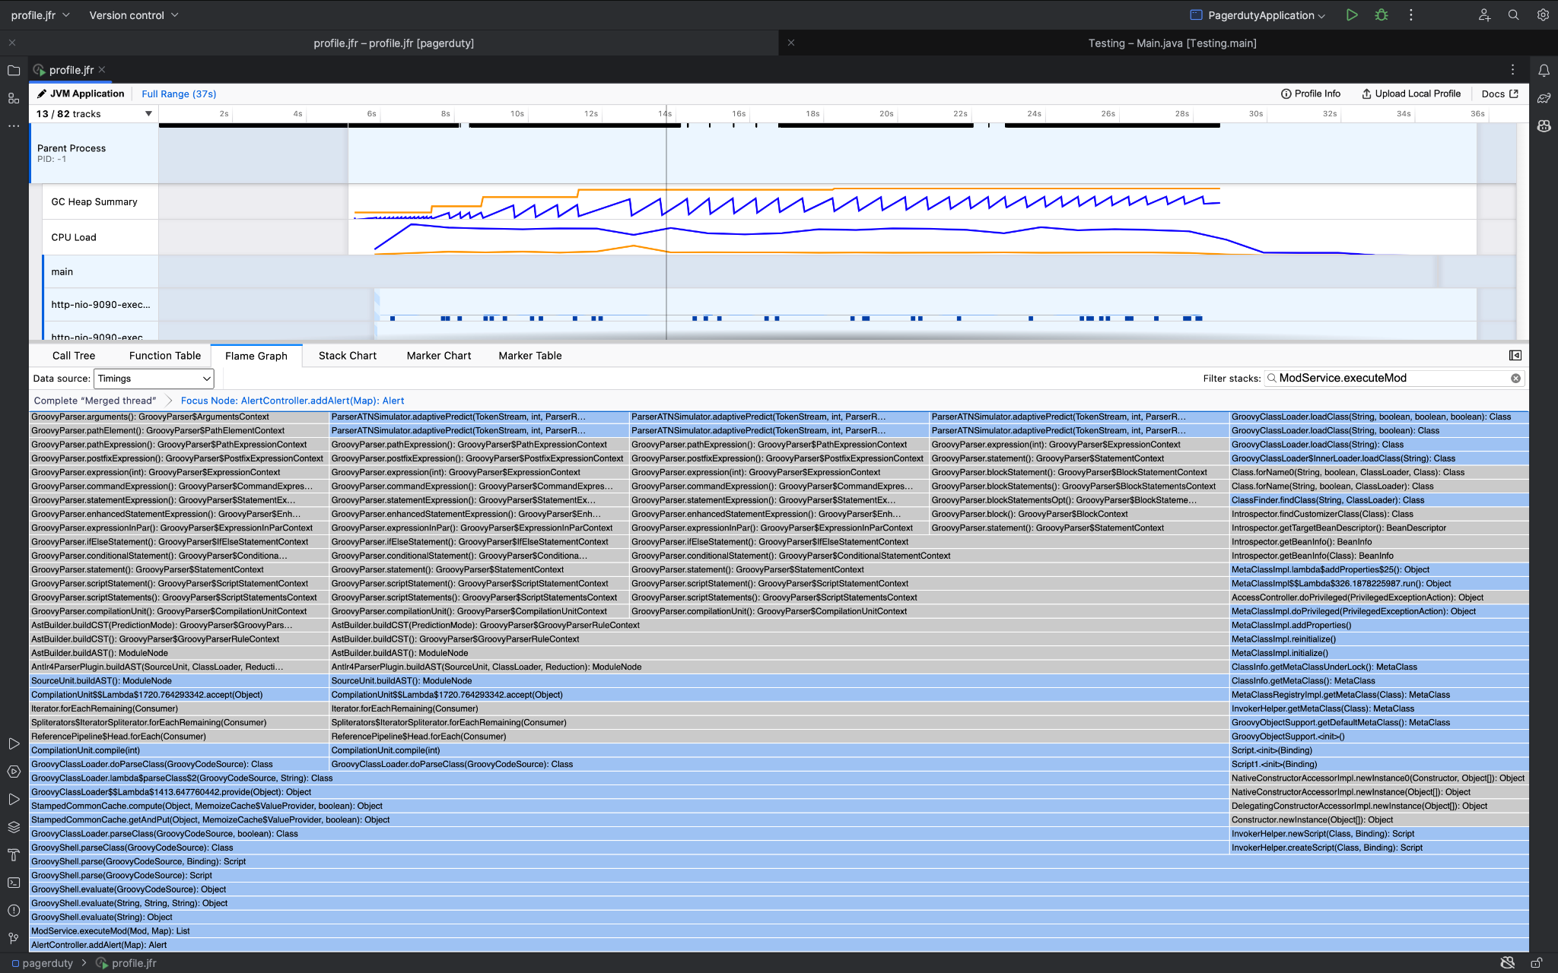
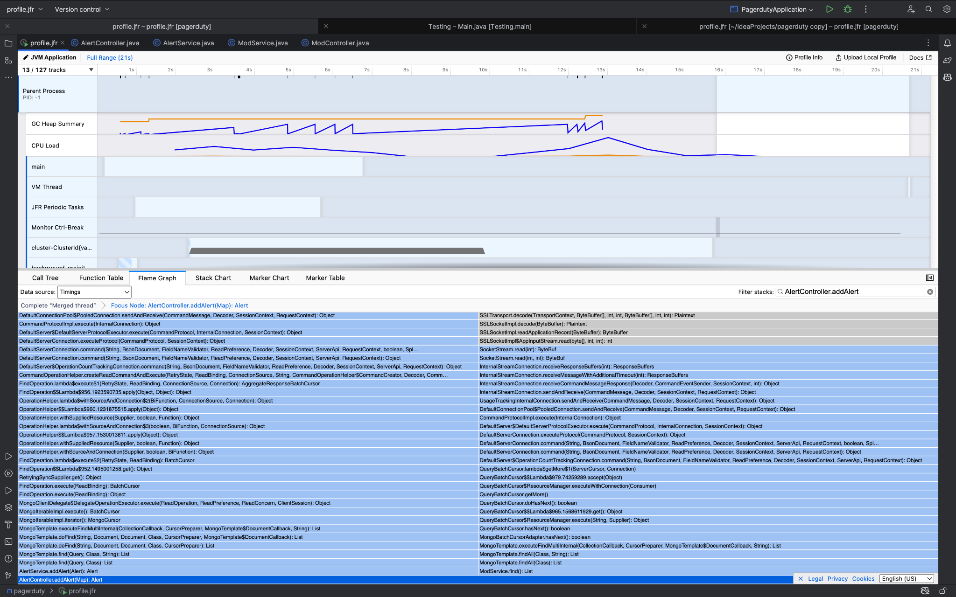
Optimization
Problem:
Multiple Binding of Dynamic Scripts
High Time Consuming
Solution:
Compile & Cache
Significantly decreases Time Consumption
© 2023 Sprinklr, Inc. CONFIDENTIAL - INTERNAL ONLY. All rights reserved.

Slide 6
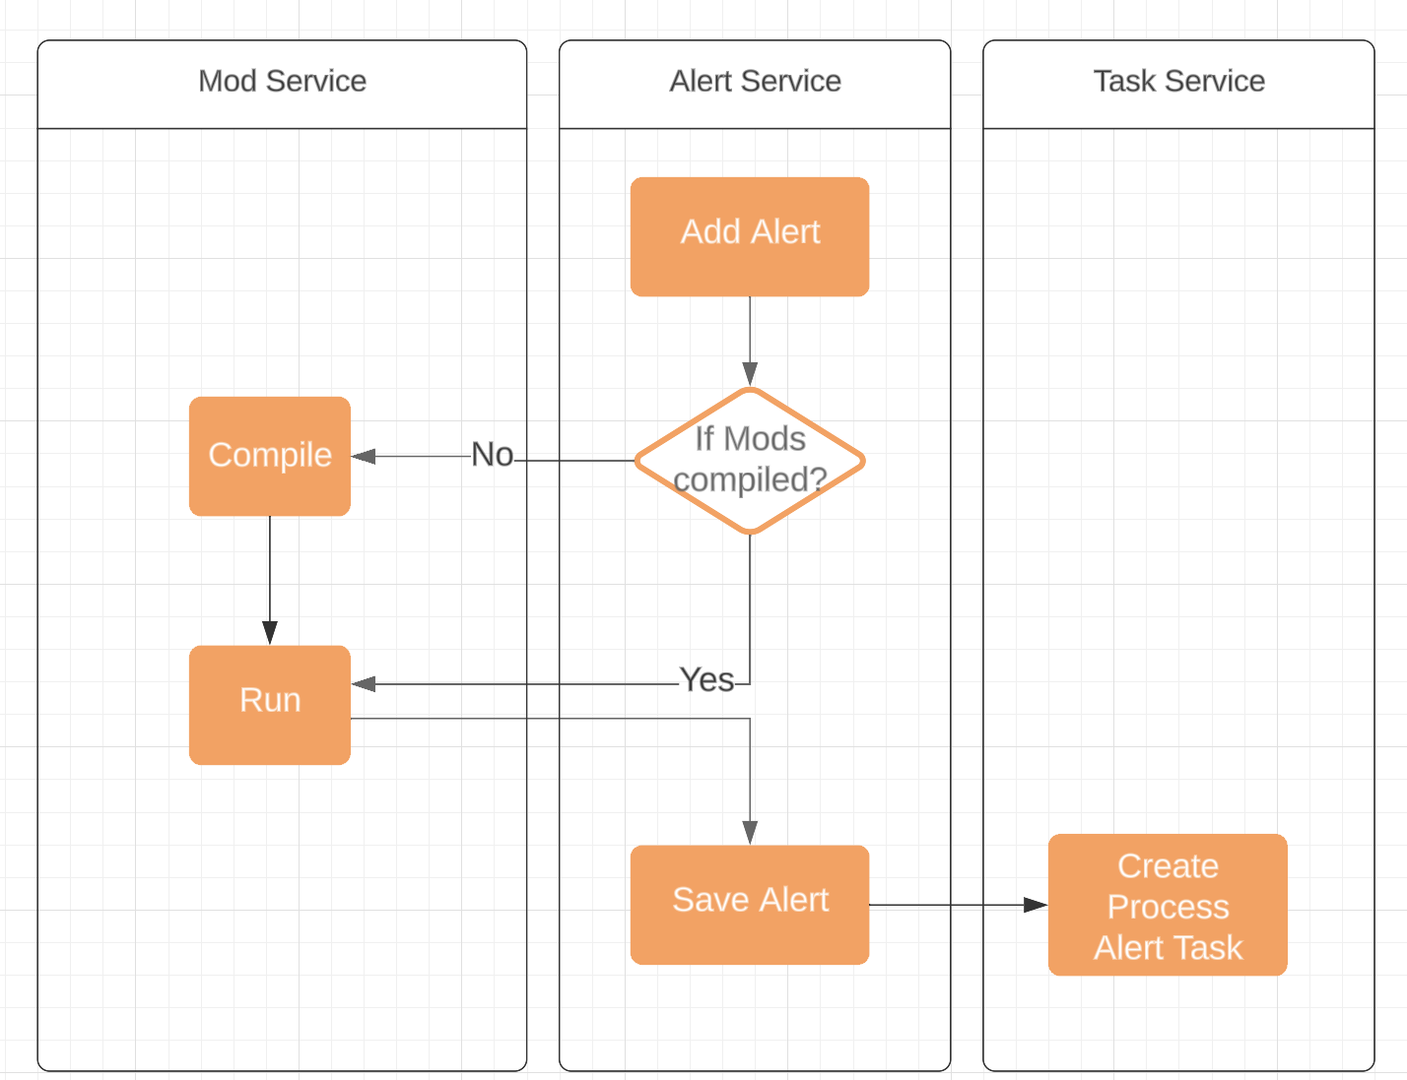
Low Level Design – Adding Alert
© 2023 Sprinklr, Inc. CONFIDENTIAL - INTERNAL ONLY. All rights reserved.

Slide 7
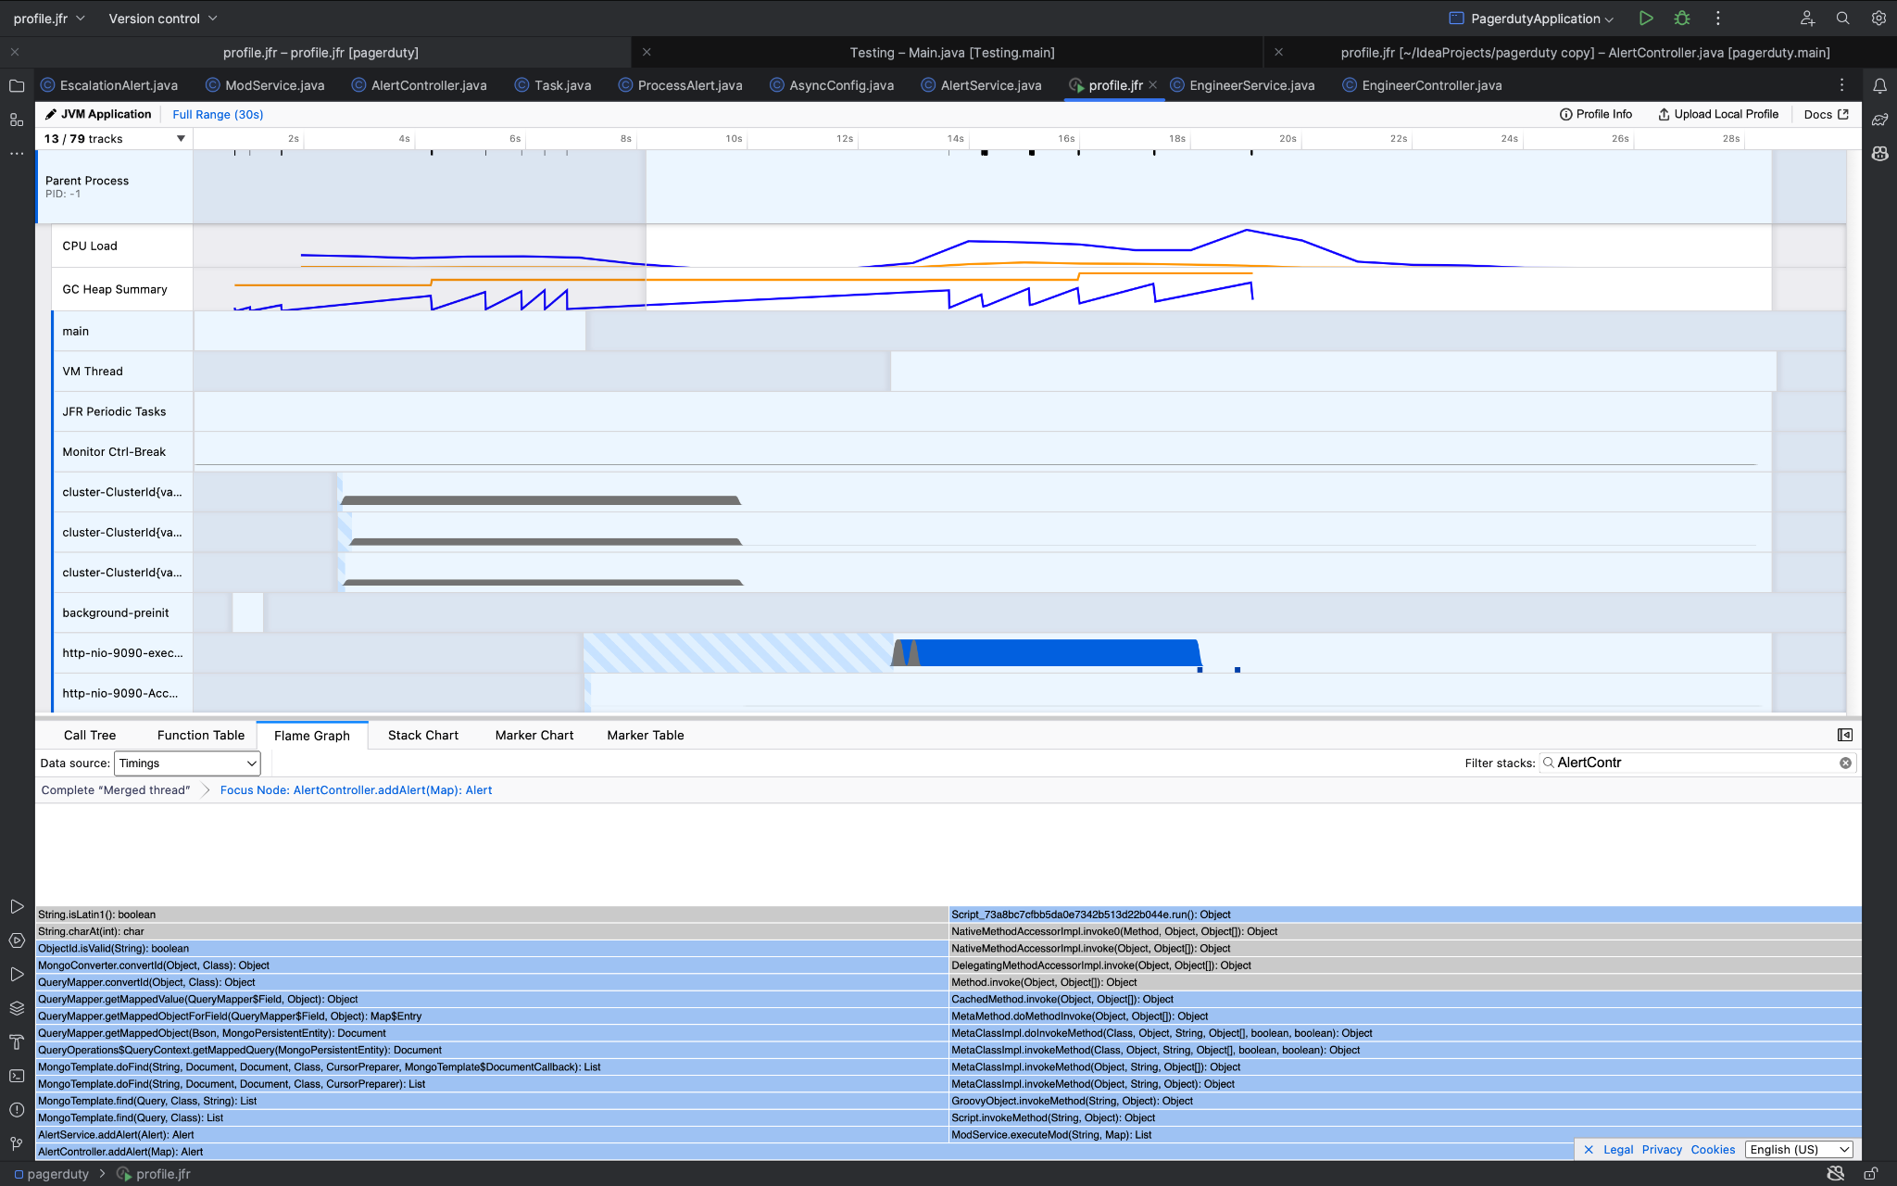
Add Alert
Basic Approach:
Get Compiled Scripts
Pass the Alert
Create a Process Alert Task
Disadvantage:
A Single Thread Approach
Time Consuming
© 2023 Sprinklr, Inc. CONFIDENTIAL - INTERNAL ONLY. All rights reserved.

Slide 8
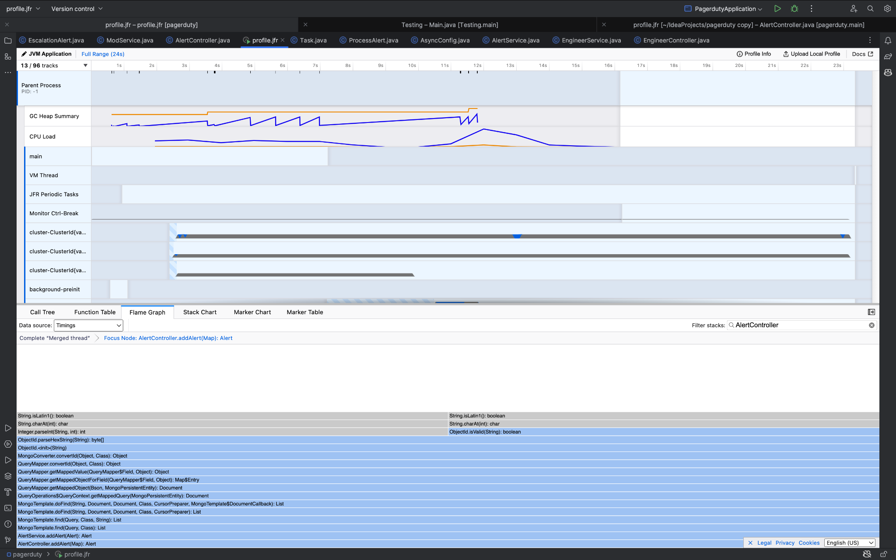
Add Alert
Multi Threading Approach:
Create Thread Pool
Create Completable Future List
Run Compiled Scripts Asynchronously
Wait for Completable Future to complete
Merge Completable Future Output
Create Process Alert Task
© 2023 Sprinklr, Inc. CONFIDENTIAL - INTERNAL ONLY. All rights reserved.

Slide 9
Scheduling Task
After Creating Tasks for a alert:
Scheduled Tasks at the fixed rate of 60 seconds
Get all the tasks with past scheduled time
Create Thread Pool for executing task
Run Task Executor Thread Pool
Generic code for Scheduling Tasks
Every Tasks should implement the interface named ScheduledTask and ApplicationContextAware
© 2023 Sprinklr, Inc. CONFIDENTIAL - INTERNAL ONLY. All rights reserved.

Slide 10
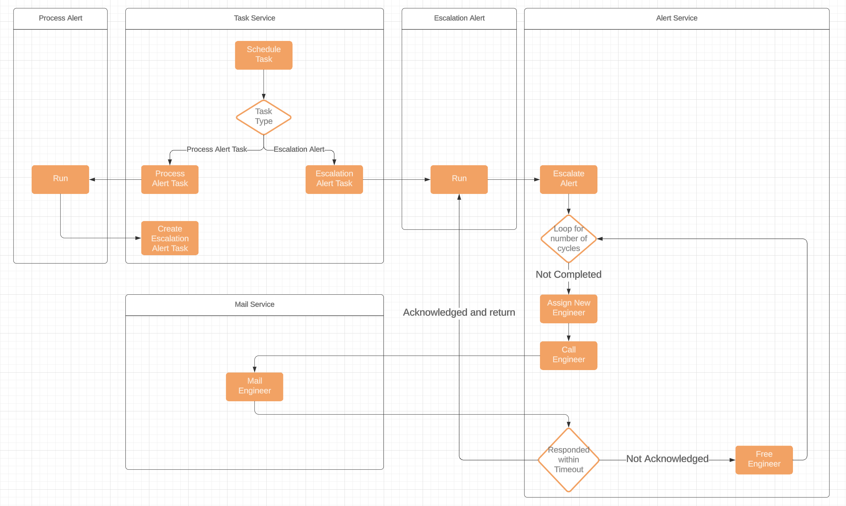
Low Level Design – Scheduling Task
© 2023 Sprinklr, Inc. CONFIDENTIAL - INTERNAL ONLY. All rights reserved.

Slide 11
Tasks
Process Alert Tasks:
Stores Alert ID in MongoDB as arguments in HashMap<String, Object>
Invoke “run” method of ScheduledTask interface
Create Escalation Alert Tasks
Escalation Alert Tasks
Stores Escalation Policy ID and Alert ID
Escalate the Alert
Call the Engineers
Handle the Acknowledgement of Escalation Policy
© 2023 Sprinklr, Inc. CONFIDENTIAL - INTERNAL ONLY. All rights reserved.

Slide 12
Call Engineers
While escalating engineers,
Email Engineers with Alert details
Provides Link of Acknowledgement through Email
Possible Outcome of Clicking Link
“Alert is already resolved”
Close the Link if Timeout
Acknowledge the Alert
© 2023 Sprinklr, Inc. CONFIDENTIAL - INTERNAL ONLY. All rights reserved.

Slide 13
Thank you
vivek.jaiswal@sprinklr.com
© 2023 Sprinklr, Inc. CONFIDENTIAL - INTERNAL ONLY. All rights reserved.

